Slide 1


LASAGNE digitaL frAmework for SmArt Grid and reNewable Energies Coordination platform
ERA-NET 108767
SFOE 810008657
Giovanna Di Marzo Serugendo
Philippe Glass

Slide 2

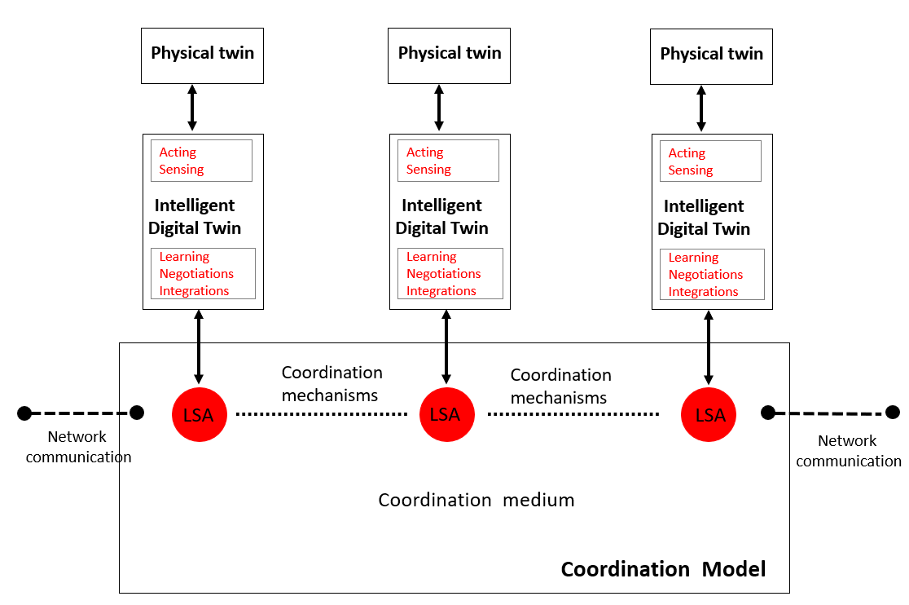
Mechanism of the coordination model
Implementation of a coordination model using digital twins, a shared virtual environment (tuple space) and coordination laws.
Presentation April 26, 2023

Slide 3
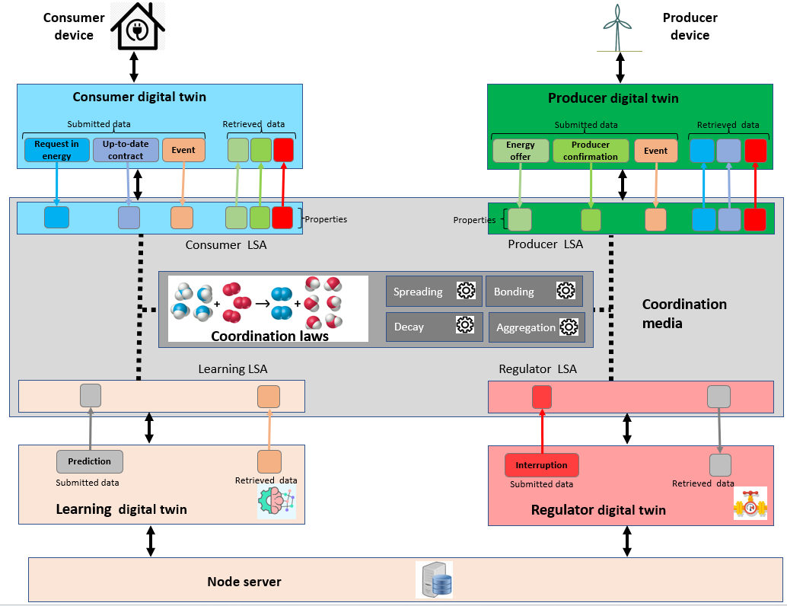
Coordination platform and digital twins
Implementation of digital twins : define agents' behaviors as consumer, producer, learning agent and node regulator. Agents act autonomously, adapt, organize and make decisions according to the situation.
Generation of supply contracts between producers and consumers by using self-adaptation.
Presentation April 26, 2023
3

Slide 4
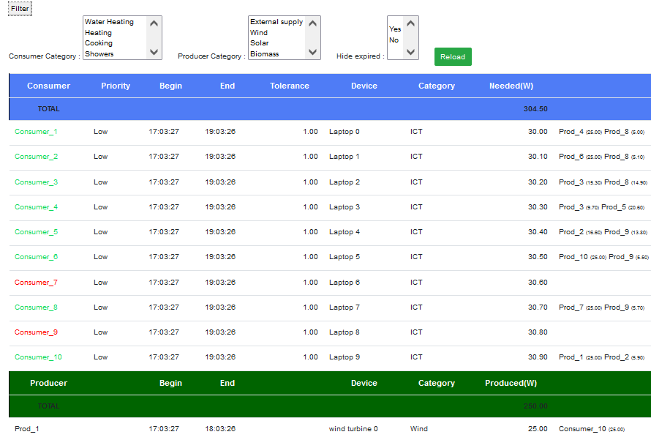










Architecture of the coordination platform
Test simulator
Web Application
web page
Request
Request
HTTP/JSON
Neighbor node 1
Response
Response
Coordination platform
Web service
RESTFUL
Controller
Node
(Micro-service)
Neighbor node 2
Digital twin (agents)
Database
Coordination platform
TCP/IP
Digital twin
Digital twin
Digital twin
Reading /
writing
« Derivative SAPERE »
kernel
LSA
LSA
LSA
…
Coordination laws
Neighbor node N
Tuples space
Coordination platform
Coordination platform
Presentation April 26, 2023
4

Slide 5
Use of databases: development environment
Database | DB type | In GED? | Size
“clemap_data” database: History of measurement data from “Les Vergers” (since May 2022) Used to simulate scenario of real production/consummation | MariaDB (relational) | No 1 instance for all nodes | 1,6 GB
“energy” database: Local events of production, demands, consumption, offers (history since the server start). (0,27 % of total size, tables : 2MB) Local prediction data (99,73 % of total size) History of local node state (labeled data for the predictions) Weight of the prediction model History of all predictions => used to generate statistics of accuracy | MariaDB (relational) | Yes 1 instance/node | 1,5 GB (Events :0,27 % , Prediction : 99,73 %)
configuration database: IP/port of the current and of the neighbour nodes. User accounts of the web application. | MongoDB (document oriented) | Yes 1 instance/node | 20 KB
Presentation April 26, 2023

Slide 6
Use of databases: Light version deployed
Database | DB type | In GED? | Size
“clemap_data” database: History of measurement data from “Les Vergers” (since May 2022) Used to simulate scenario of real production/consummation Question: how to get real-time data? | MariaDB (relational) | No 1 instance for all nodes | 1,6 GB
“energy” database: Local events of production, demands, consumption, offers (history since the server start). (0,27 % of total size, tables : 2MB) [TO KEEP?] Local prediction data (99,73 % of total size) History of local node state (labeled data for the predictions) Weight of the prediction model History of all predictions => used to generate statistics of accuracy | Where to store history? SQL Lite | No / Yes 1 instance/node Remove / Check with Learning | 1,5 GB (Events :0,27 % , Prediction : 99,73 %) Learning?
configuration database: IP/port of the current and of the neighbour nodes. User accounts of the web application. | SQL Lite or Configuration file (not dynamic) | Yes 1 instance/node | Storage: 20 KB Gain in RAM
Presentation April 26, 2023

Slide 7
Use of sub-modules
Sub-module | Status
SAPERE Kernel
Tuple space | essential
Coordination laws (Bonding, Spreading, Decay, Aggregation) | essential
Node manager (reception/delivery of LSAs of neighbour nodes) | essential
Learning of service evaluation (with reinforcement learning) no used | to remove
Digital twins
Producer/consumer | essential
Regulator | essential
Learning : history of energy events (demands, production, consumption) Predictions | to reduce (no prediction, no learning statistics …)
Rest service
Rest controller : handling requests to add/modify/delete producer and consumer digital twins To display the node content (current view, history view, learning model) | essential
Presentation April 26, 2023

Slide 8
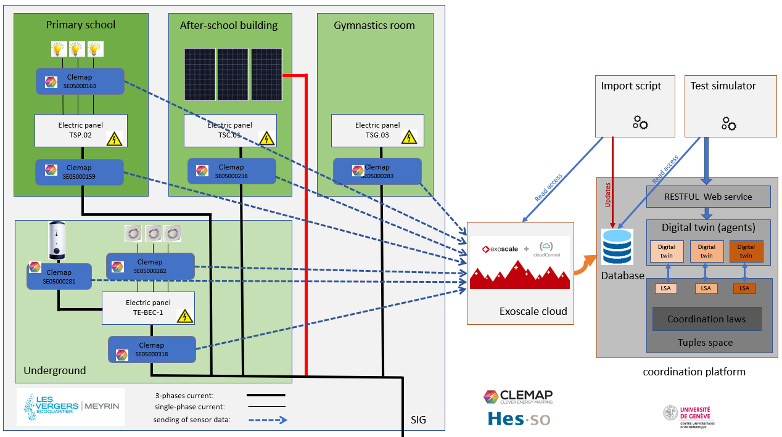
Use of “clemap_data” database
Measurement data from “Les Vergers”
Presentation April 26, 2023

Slide 9
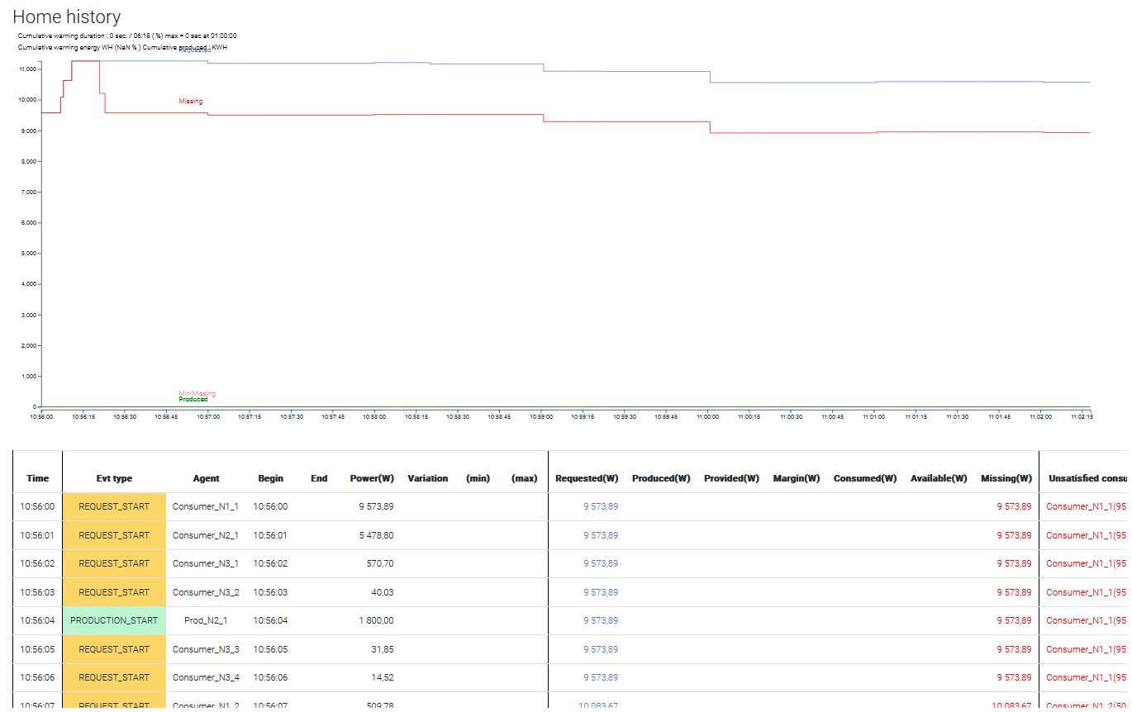
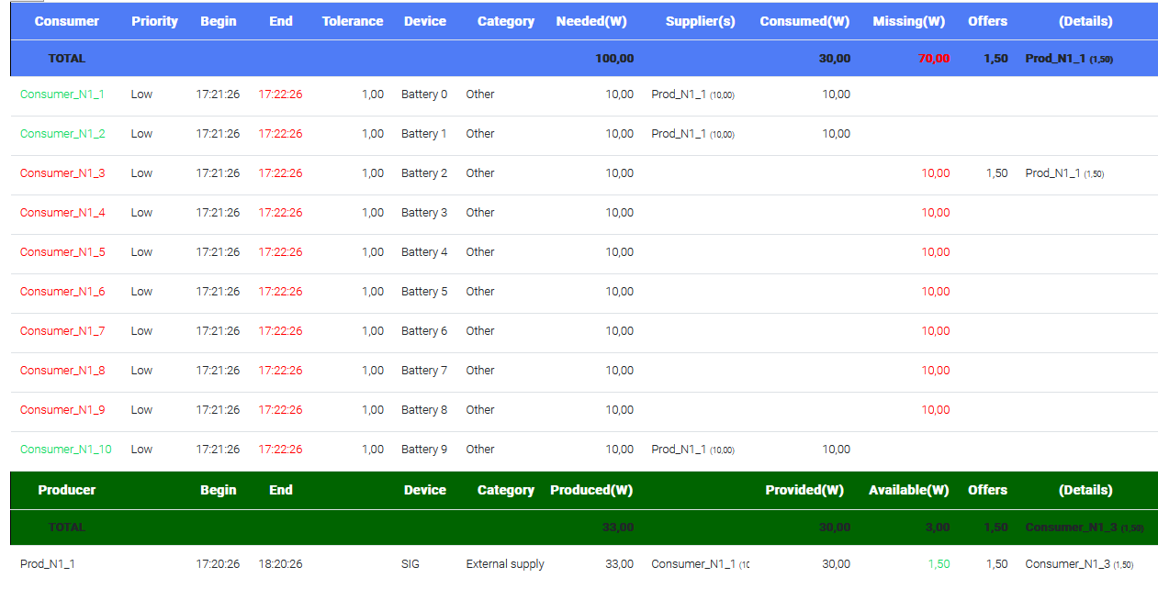
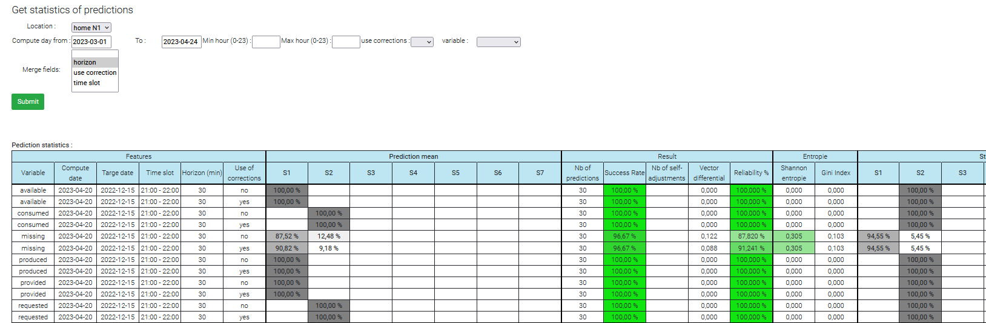
Use of “energy” database
Production/consumption history at the node level
Predictions history at the node level
Presentation April 26, 2023

Slide 10
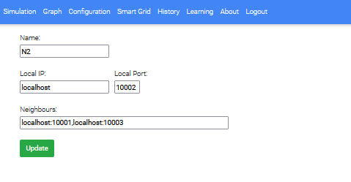
Use of node config database (mongodb)
Configuration of the node address and direct neighbours.
Presentation April 26, 2023

